Slide 1

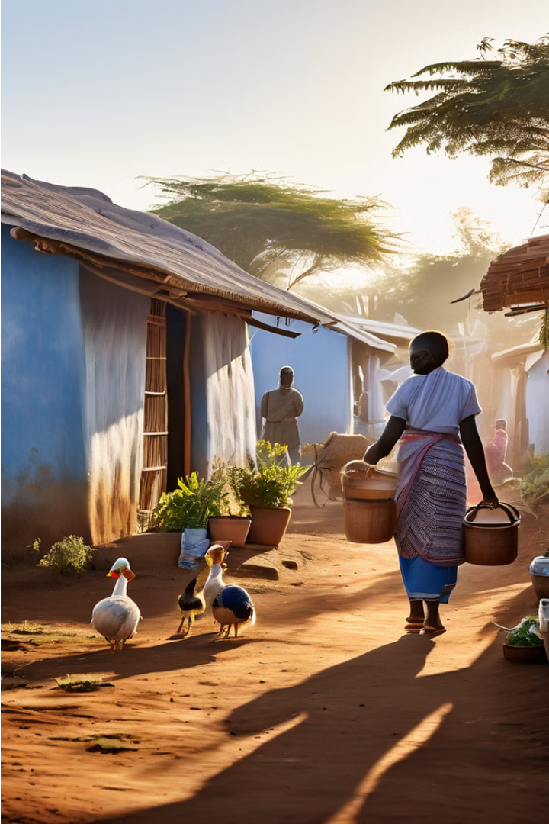


Sondu women group indigenous chicken farming : Empowering Communities through Indigenous Chicken Farming
The Sondu women group has embraced the traditional practice of indigenous chicken farming, creating a sustainable and empowering livelihood for their community. By preserving this time-honored tradition, they are not only generating vital income, but also enriching the lives of those around them.
by Judith Akinyi

Slide 2
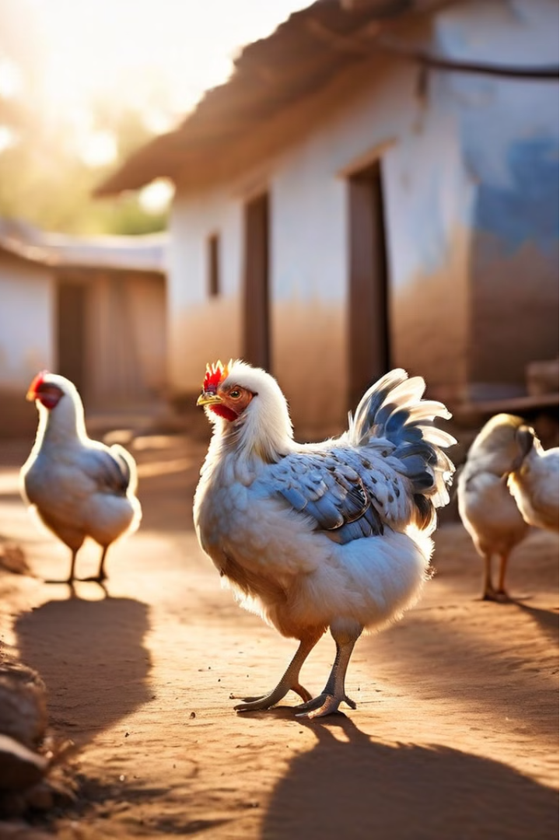
Problem Statement
Despite their resilience, unique flavor, and cultural significance, indigenous chicken breeds in the region remain underutilized. The Sondu indigenous chicken farming women group aims to address this issue by promoting indigenous chicken farming as a sustainable livelihood option. Their goal is to preserve biodiversity and empower rural communities through this initiative, which taps into the inherent advantages of these hardy, heritage chicken breeds.
The women-led group recognizes the valuable role that indigenous chickens can play in supporting local food systems and economies. By bringing attention to these overlooked breeds, they hope to spur greater adoption and appreciation for this important component of the region's agricultural heritage and traditions.

Slide 3
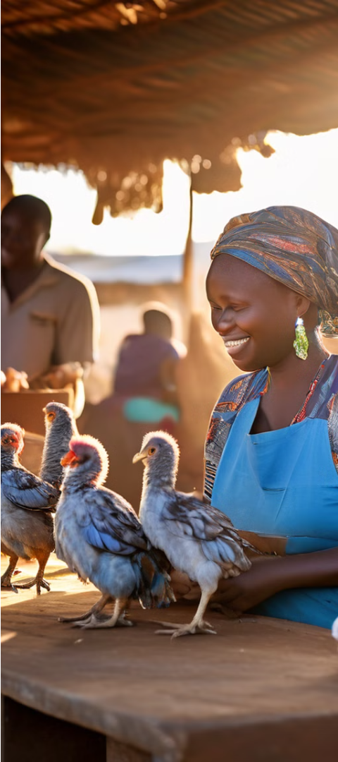
Market Opportunity
Growing Consumer Demand
Valued Attributes
There is a rising interest among consumers for locally sourced, ethically produced poultry products, including indigenous chicken meat and eggs. This trend reflects a desire for authentic, nutritious foods that support local economies.
Conscientious consumers are seeking out products that align with their values, such as sustainability, animal welfare, and community empowerment. Indigenous chicken farming presents an opportunity to cater to these preferences.
Sondu's Unique Offering
The Sondu indigenous chicken farming women's group is poised to capitalize on these market trends by providing high-quality, ethically raised indigenous chicken products that meet the growing demand for authentic, locally-sourced foods.

Slide 4

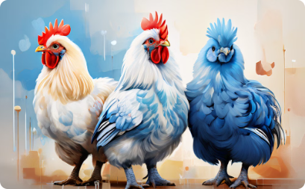

Our Solution
Community-Focused Approach
Breeding Program
Sustainable Practices
We maintain a diverse gene pool of indigenous chicken breeds, prioritizing traits like disease resistance, delicious flavor, and adaptability to local environments. This ensures the long-term sustainability of these valuable genetic resources.
Our farming methods emphasize natural feed, free-range environments, and minimal use of antibiotics. This approach prioritizes the health and welfare of the chickens while ensuring environmental sustainability.
Sondu indigenous chicken farming partners with local communities to promote indigenous chicken farming. We provide training, resources, and market access, empowering women and strengthening local food systems.

Slide 5
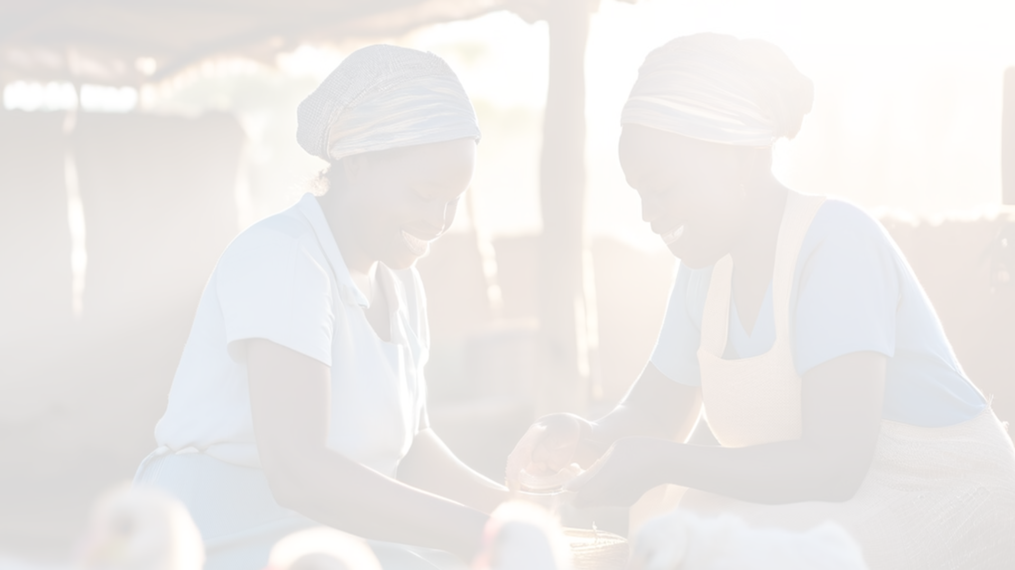
Business Model
Community Partnerships
Revenue Streams
Social Impact
The Sondu indigenous chicken farming women's group generates revenue through the sale of chicks, mature chickens, eggs, and value-added products like smoked chicken and feather crafts, creating a diverse and sustainable business model.
By empowering local communities and promoting sustainable agriculture, our business model creates a positive social impact that extends beyond just financial returns, contributing to the overall wellbeing of the communities we serve.
We collaborate closely with rural communities, providing them with high-quality chicks, comprehensive training, and ongoing support to ensure their success in indigenous chicken farming.

Slide 6
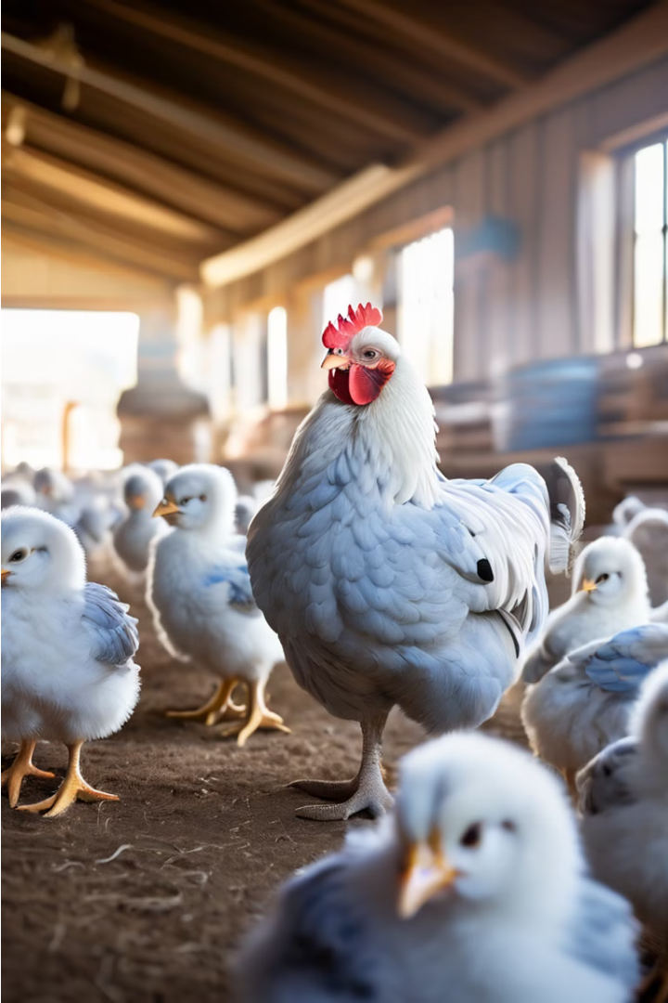
Competitive Landscape
At Heritage Hatchery, we stand apart from industrial poultry producers through our unwavering commitment to heritage chicken breeds, community engagement, and sustainable practices. While our competitors focus on efficiency and uniformity, we position ourselves as champions of biodiversity, tradition, and rural development.
Our brand identity resonates strongly with ethical consumers seeking authentic and socially responsible products. By highlighting the cultural and ecological value of indigenous chicken farming, we appeal to those who want to make a positive impact through their purchasing choices. This differentiated approach allows us to carve out a unique niche in the market.

Slide 7
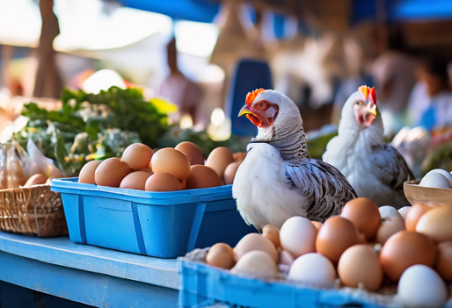
Marketing Strategy
Storytelling
Educational Campaigns
We leverage the rich cultural heritage of indigenous chicken farming to connect with consumers on a deeper level. By highlighting the centuries-old traditions and the women-led stewardship of this industry, we create an emotional bond that resonates with our target audience.
The Sondu indigenous chicken farming women group spearheads educational initiatives to inform consumers about the nutritional benefits, cultural significance, and positive environmental impact of indigenous chicken farming. This helps build awareness and trust in our products.
Market Access
We utilize a diverse range of distribution channels to reach our target audience, including farmer's markets, specialty stores, online platforms, and community events. This multi-faceted approach ensures that our indigenous chicken products are accessible to ethically-minded consumers in both urban and rural areas.

Slide 8
Financial Projections
Based on our market analysis and production capacity, we project sustainable revenue growth over the next five years. Our low-input farming methods and community-based approach result in favorable profit margins, offering investors an opportunity to support a socially impactful venture with strong growth potential.
30M
65%
$10M
Revenue
Profit Margin
Investment Opportunity
Projected annual revenue of $30 million by year 5, driven by growing demand for indigenous chicken products.
Favorable profit margins of 65% due to our efficient, low-cost production methods and community-based model.
Seeking $10 million in investment to scale our operations and expand our impact across rural communities.

Slide 9




Milestones
Short-Term Goals
In the short-term, we aim to establish strong partnerships with local communities, set up state-of-the-art hatcheries, and launch impactful marketing campaigns to raise awareness about the benefits of indigenous chicken farming.
Medium-Term Goals
As we scale our operations, our medium-term goals include expanding our production capacity, developing robust distribution networks to reach more communities, and introducing value-added products that showcase the unique qualities of our indigenous chicken breeds.
Long-Term Vision
Our long-term vision is to become a leading producer of indigenous chicken products, renowned for their exceptional quality, authenticity, and commitment to social responsibility. We aspire to empower rural communities, preserve traditional farming practices, and inspire a new generation of ethical consumers.

Slide 10

Thank You
We deeply appreciate your interest in the Sondu indigenous chicken farming women group. Together, we have the opportunity to build a more resilient, inclusive, and sustainable food system that empowers rural communities and honors traditional agricultural practices. Your support is invaluable as we work to create positive change and ensure that nutritious, culturally-relevant foods remain accessible to all. With your partnership, we can cultivate a future where indigenous wisdom and modern innovation thrive in harmony.

